Slide 1
My Youth Friends
Resilience Programme For 12-15 year OLDS

Slide 2
Developing Social and Emotional Intelligence
‘’Intelligence is measured by academic performance Social and Emotional Intelligence play a big role in developing a child to be all that they can be’’
Friends is concerned with :
Building emotional skill
Building Social Skills
Resilience strategies

Slide 3
What Does Friends Acronym stand for?
F = Feelings
R= Remember to relax
I= Inner helpful thoughts
E= Explore solutions and coping Step Plans
N= Now reward yourself
D= Don’t forget to practice the skills you have learnt
S= Stay Strong Inside

Slide 4
Structure
There are 10 Sessions
It may take more than one lesson to cover each session
We work at the pace to suit the group and don’t rush on if a topic needs exploring further
They will take place weekly
They are at different times so that they don’t miss out in any one subject area
The group consists of 10 students who have been selected by the Pastoral Team because we feel they will benefit as individuals from taking part
It is not compulsory

Slide 5
The Friends Programme
This is an evidence based research based research programme. The research tells us that 80% of children showing signs of anxiety disorder no longer display that disorder after completing the programme.
We do a pre and post questionnaire which is evaluated by our CAMHS team called the Spence Children’s Anxiety Scale
We also have our own school designed evaluation

Slide 6
Here is what some of our students have said after taking part in the programme.
‘’I feel that the Friends Programme has helped me to build my confidence in class’’
‘’ I feel less stressed and nervous around other people’’
‘’ I think we should have this for everyone’’
‘’ I like this group… I learn new things’’
‘’ I have a lot more confidence and have not been afraid of what people thought of me’’
The Friends group has helped me academically because I am getting higher levels now I am more confident’’
I am a bit more confident in class (putting my hand up or doing presentations)’’
I worry less after being in Friends Group’’
I found this group helpful because I can socialise with others and I can talk to other children without stuttering and without running off’’

Slide 7
How Can you Help?
Do the Friends homework together
Get your child to keep a diary and write down one thing every day that has been a positive experience
Talk every day about happy, fun things that have happened during the day
Do happy, fun things together eg. Share a meal/ go for a walk and talk/ recycle and feel good about doing something positive
Reward your child for these positive things they are able to share with you

Slide 8
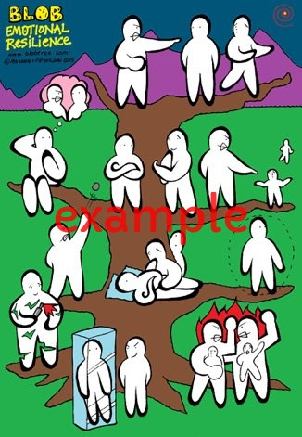
Where Are You on the Tree?

